Slide 1

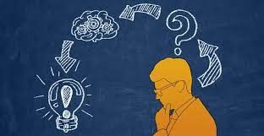
INTRODUCTION TO LOGIC
SINTO JOSE PORATHUR

Slide 2
INTRODUCTION
Man is a rational animal. Hence it is natural for man to seek knowledge.
When this knowledge-seeking enterprise of man attains a definite structure, aim and method, it is called a science.

Slide 3
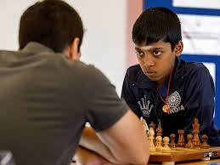

Slide 4
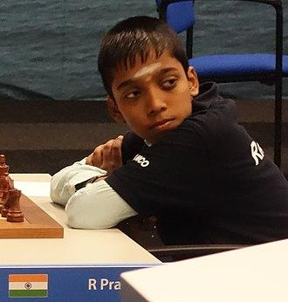
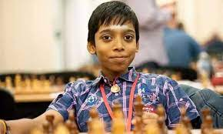
Rameshbabu Praggnanandhaa

Slide 5

Magnus Carlsen (Norway)

Slide 6
https://www.youtube.com/watch?v=Q3edQ35f6kk
https://www.youtube.com/watch?v=ut1TLRPSfiI

Slide 7
Our various sciences are all concerned with the same great system of things that we call nature.
But each branch of science deals with only one or other aspect of it.

Slide 8
Knowledge: Direct and Indirect
Knowledge is the organization of ideas. We can speak of direct and indirect knowledge.
Direct knowledge is the knowledge attained through the sense organs.
In experiments and discoveries, physical sciences base themselves mainly on direct knowledge.

Slide 9
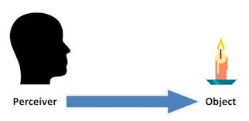

Slide 10
Indirect knowledge, on the other hand, is attained through a mental process.
In this process, reason is the instrument of our mind and it enables us to know the unknown from the known facts.
Reason has proved itself to be the most success instrument that one can rely upon in any serious intellectual pursuit.

Slide 11
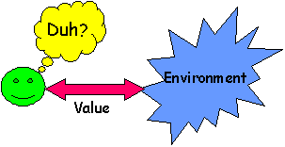

Slide 12
“Errare humanum est”
The fact that we fall into error naturally raises the question whether rules can be laid down by adherence to which errors can be avoided.
Logic helps us to distinguish between what is true and what is false.
It gives us the rules for correct reasoning.

Slide 13
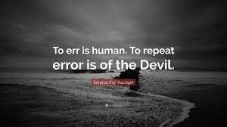
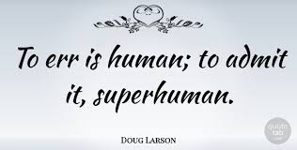

Slide 14
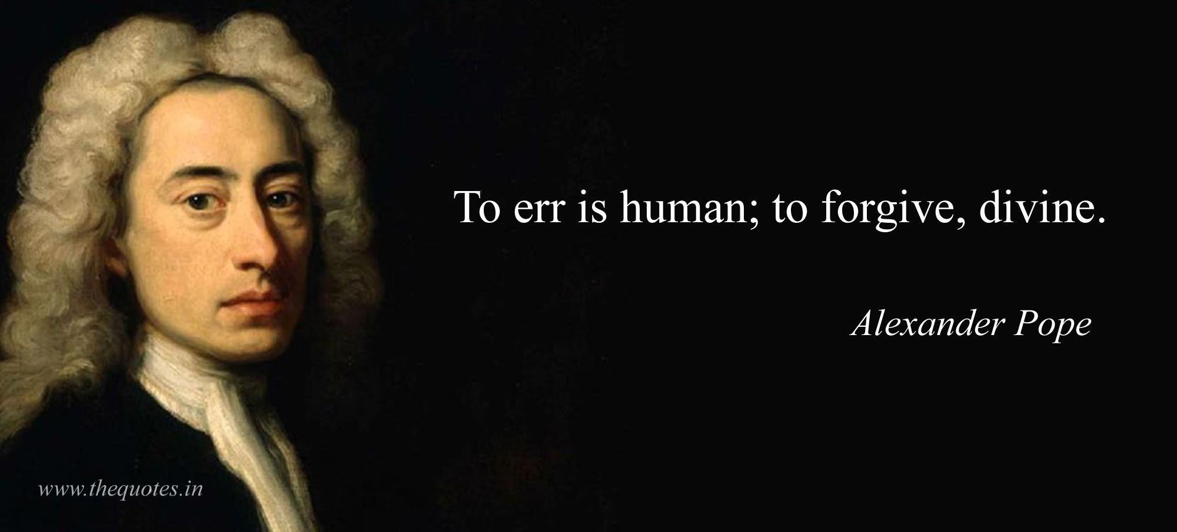

Slide 15
Alexander Pope
Alexander Pope (21 May 1688 O.S. – 30 May 1744) was an English poet, translator, and satirist of the Enlightenment era who is considered one of the most prominent English poets of the early 18th century.
An exponent of Augustan literature, Pope is best known for his satirical and discursive poetry including The Rape of the Lock, The Dunciad, and An Essay on Criticism, and for his translations of Homer.

Slide 16
Searching for a Definition of Logic
Etymologically the word LOGIC is derived from the Greek word LOGOS.
Logic is frequently defined as “the science of thinking” or “the science of laws of thought”.
Thinking is the act of the intellect by which knowledge is attained.

Slide 17
But this definition is not accurate.
First of all, ‘thinking’ is studied also by Psychology; psychology also is also a science which deals with the laws of thought and Logic is not a branch of psychology, it is distinct field of study.

Slide 18
Secondly, ‘thought’ refers to any process that occurs in people’s minds.
Not all thought is an object of study for the logician.
All reasoning is thinking, but not all thinking is reasoning.

Slide 19
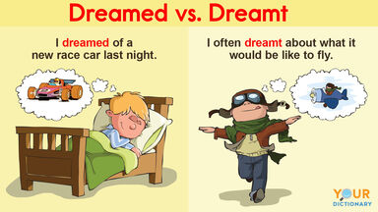

Slide 20
There are many mental processes or kinds of thought that are different from reasoning.
One may have daydreams, may remember something or imagine it, or regret it without doing any reasoning about it.

Slide 21


Slide 22
Or one may let one’s thoughts “drift along” in a daydream or reverie, following what psychologists call free association, in which one image is replaced by another in an order that is not logical.
Though these all are process in people’s minds there is no logic in these.

Slide 23
Logic is an art and science of reasoning
This definition too is not complete, because reasoning is not the only subject matter of logic.
Reasoning is a special kind of thinking in which conclusions are drawn from premises.

Slide 24
But the mental process of reasoning is studied also by psychologists.
As they examine reasoning process, they are interested in the faculty or capacity of the mind to reason and the mental process of how the mind works in the process of reasoning.
But logic studies the correctness of the conclusion.

Slide 25
There is another definition which very many of the logicians accept.
“Logic is the study of the methods and principles used to distinguish good (correct) reasoning from bad (incorrect) reasoning”.

Slide 26
Creighton gives the complete and correct definition of Logic as follows.
“Logic is a Science that deals with the operations of the mind in its search for Truth.”

Slide 27
Hence three things are necessary for the correct definition of Logic, namely.
· It is a Science
· Its subject matter is the operations of the mind.
· Its aim is the attainment of truth.

Slide 28
Logic is a Science
Every branch of science should have the following three characteristics.
(a) It should deal with a part of the universe,
(b) It should be systematic and organized body of knowledge,
(c) It should give us certain and correct knowledge.

Slide 29
Logic confines itself to the operations of the human mind – that is, it deals with the part of the universe namely, mind.
Logic gives us systematic and organized knowledge regarding the correct thinking and the knowledge thus given is correct, certain and precise.

Slide 30
Logic Deals with the Operations of the Mind
There are three operations of the human mind, namely,
Conception,
Judgment, and
Reasoning.

Slide 31
Conception
Conception is the function of the human mind by which a mental image is formed in the mind. This mental image is called an idea or a concept.
For example, we see a camel and form an idea of a camel in our mind.

Slide 32
When we express an idea in language it is known as a term.

Slide 33
Judgment
Judgment is another operation of the human mind by which one idea is either affirmed or denied of another.
Hence every judgment should have at least two ideas.

Slide 34
For example, Chalk is white is a judgment and it is an affirmative judgment for whiteness is affirmed of the chalk.
Chalk is not red is a negative judgment for redness is denied of the chalk.
When a judgment expressed in words it is known as a proposition.

Slide 35
Reasoning
The third operation of the human mind is reasoning. Reasoning is “the mental process passing from two known judgments to a new judgment”.
For example, from the two known judgments, ‘all men are mortal’ and ‘Socrates is a man,’ we draw the new judgment that ‘Socrates is mortal’.
When reasoning is expressed in words it is called an argument.

Slide 36
The Aim of Logic is the Search for Truth
Truth can be either formal or material.
Formal truth means agreement of ideas among themselves. For example, “square circle” is formally false because the two ideas do not agree with each other.
On the other hand, “Golden Mountain” though not real, is formally true because ideas do not contradict each other.
Material truth means agreement of ideas with the corresponding objects in the external world; example, that rose is red.

Slide 37
One who has studied logic is more likely to reason correctly than on who has never studied….
The student will approach it as an art and science and the student will do exercise in all parts of the theory being learned.
Analysis of fallacies- give increased insight into the principles of reasoning in general and an acquaintance with these pitfalls helps to keep us from stumbling into them.
The study of logic will give students techniques and methods for testing the correctness of many different kinds of reasoning, including their own.

Slide 38
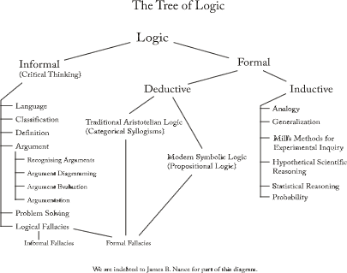

Slide 39
Suggested Readings
Cohen R. Moris and Ernest Nagel, An Introduction to Logic and Scientific Method
2. Irving M. Copi, Symbolic Logic

